Slide 1
CS250 Lecture 42 – Energy and power
2017.12.04
We believe that electricity exists, because the electric company keeps sending us bills for it.
- Dave Barry

Slide 2
Assignment
Today covering chapter 20
Read chapters 21 and 22; skim chapter 19
HW12 due Thursday, Dec. 07

Slide 3
Final exam information
Final exam covers
Textbook chapters 1 through 22
All lectures
All homeworks
All labs
Final exam format
50 multiple choice questions at 3 pts. each
Some emphasis on material since Midterm 2, yet, comprehensive coverage of the semester
Closed book, closed notes, no calculators

Slide 4
Power and energy constraints are now the driving force in all devices from servers to smartphones.
– Kathryn McKinley
Microsoft, 2013

Slide 5
in amperes

Slide 7
And do I want to pay that much? Usually there is an energy charge (kilowatt-hours) and a peak power fee (based on maximum power demand)
Battery stores a quantity of energy
For portable devices, typical units of energy are watt-hours

Slide 9
Energy is a function of V_{dd}², so small reductions in V_{dd} reduce energy
by larger amounts. This is the reason for the many V_{dd} levels of the
Intel Core i7 chip could select: fine-grained control of energy use.
Challenge: Must maintain an adequate separation of the
voltage bands for logic 0 and logic 1. With one band lower bounded by
zero, or ground, and the other upper bounded by V_{dd} the noise margin,
the voltage range separating 0 and 1, limits how low V_{dd} can go.

Slide 10
Limit to reducing V_{dd} is necessary voltage band range and logic signal noise margin
V_{dd}
Voltage band recognized as logic 1
Bands must cover sufficient voltage range so that a worst case transistor cannot cause gate to fail to operate properly, i.e.,
digitally
Voltage
Zone of noise margin
Voltage band recognized as logic 0
0

Slide 11
Limit to reducing V_{dd} is necessary voltage band range and logic signal noise margin
V_{dd}
Voltage band recognized as logic 1
Bands must cover sufficient voltage range so that a worst case transistor cannot cause gate to fail to operate properly, i.e.,
digitally
Voltage
Zone of noise margin
Voltage band recognized as logic 0
0
Must maintain band structure for digital operation
Noise margin must exceed noise magnitude to prevent errors

Slide 12
This is a major reason why processor chip clock speeds are not going up; fast clocks burn power. Then there is Amdahl’s Law: Crank up the CPU clock enough to make L1 access take 2 clock cycles and (1) it’s hard to keep up instruction fetch, (2) L1 load hits cause delay, (3) L1 store hits need a buffer. These “de-enhancements” are f_{d-e} ≃ 20%.

Slide 14
Notes:
Stovetop coil glowing red-orange is around 1100K and requires ~50W/in^2 or about 8W/cm^2
Surface of the Sun emits about 6.3KW/cm^2 (5800K black body radiation)
Galileo probe faced 50KW/cm^2 at about 14,000K for ~60 seconds on Dec. 07, 1995

Slide 15
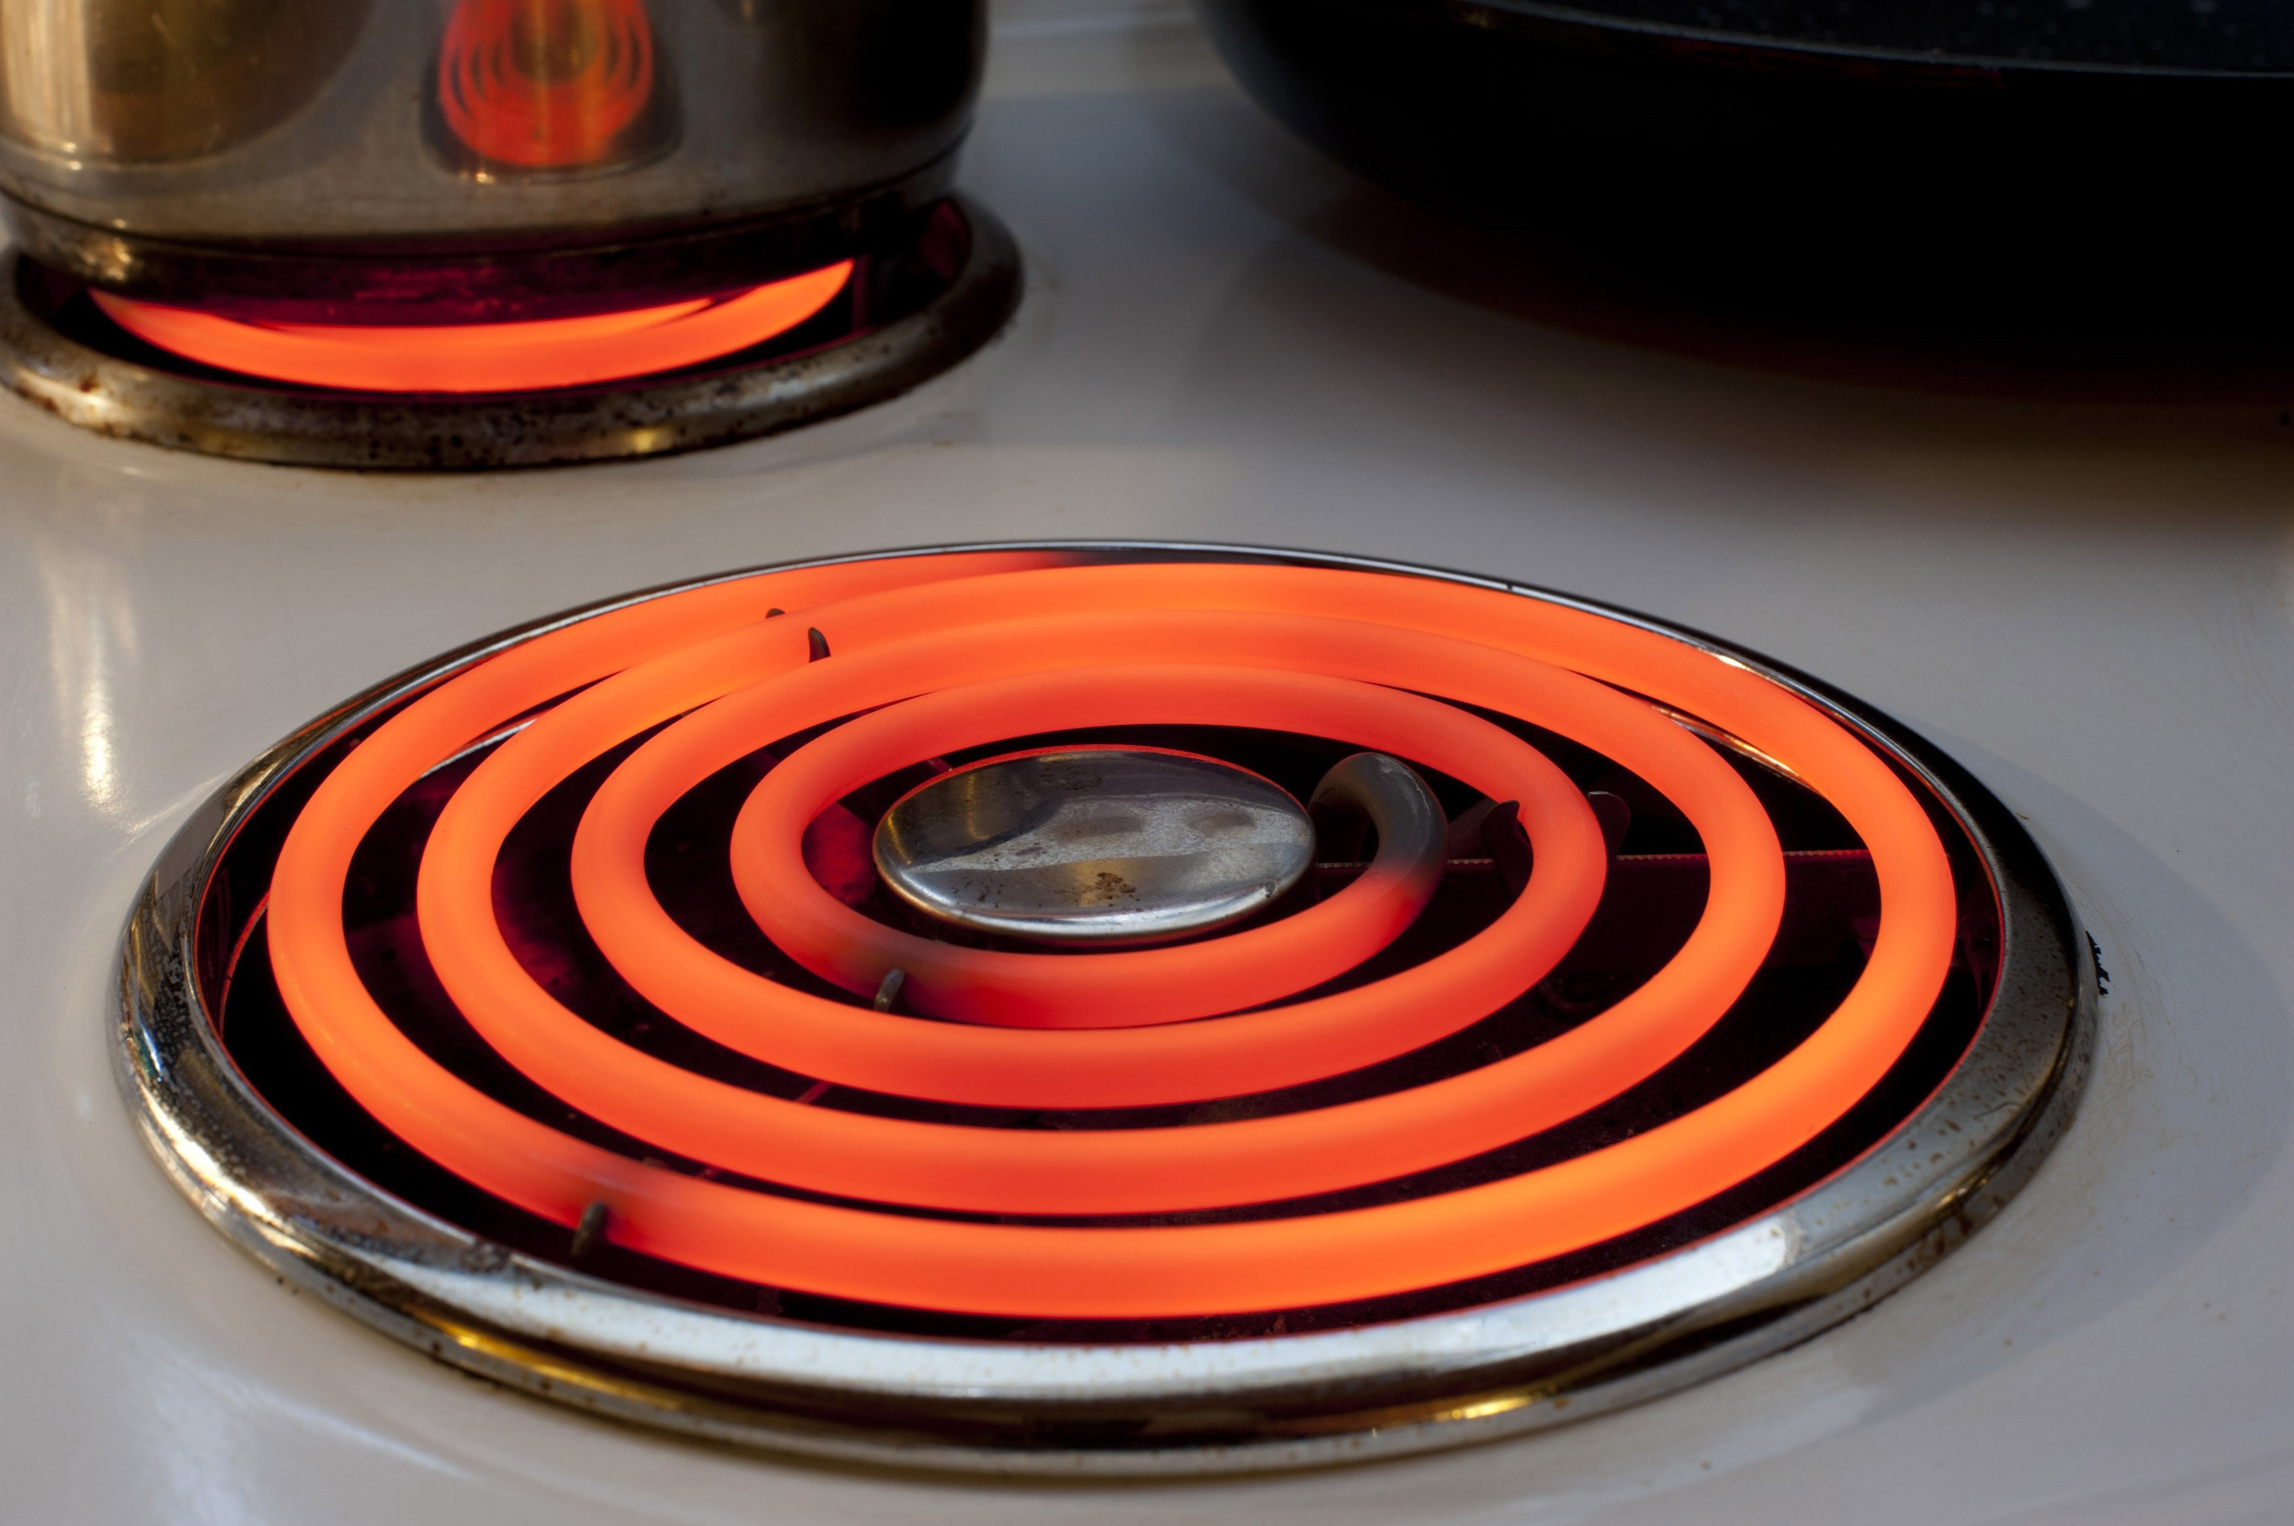
300˚K still-air cooling of 6 W/cm2 yields 1100˚K
Photo from freefoodphotos.com

Slide 16
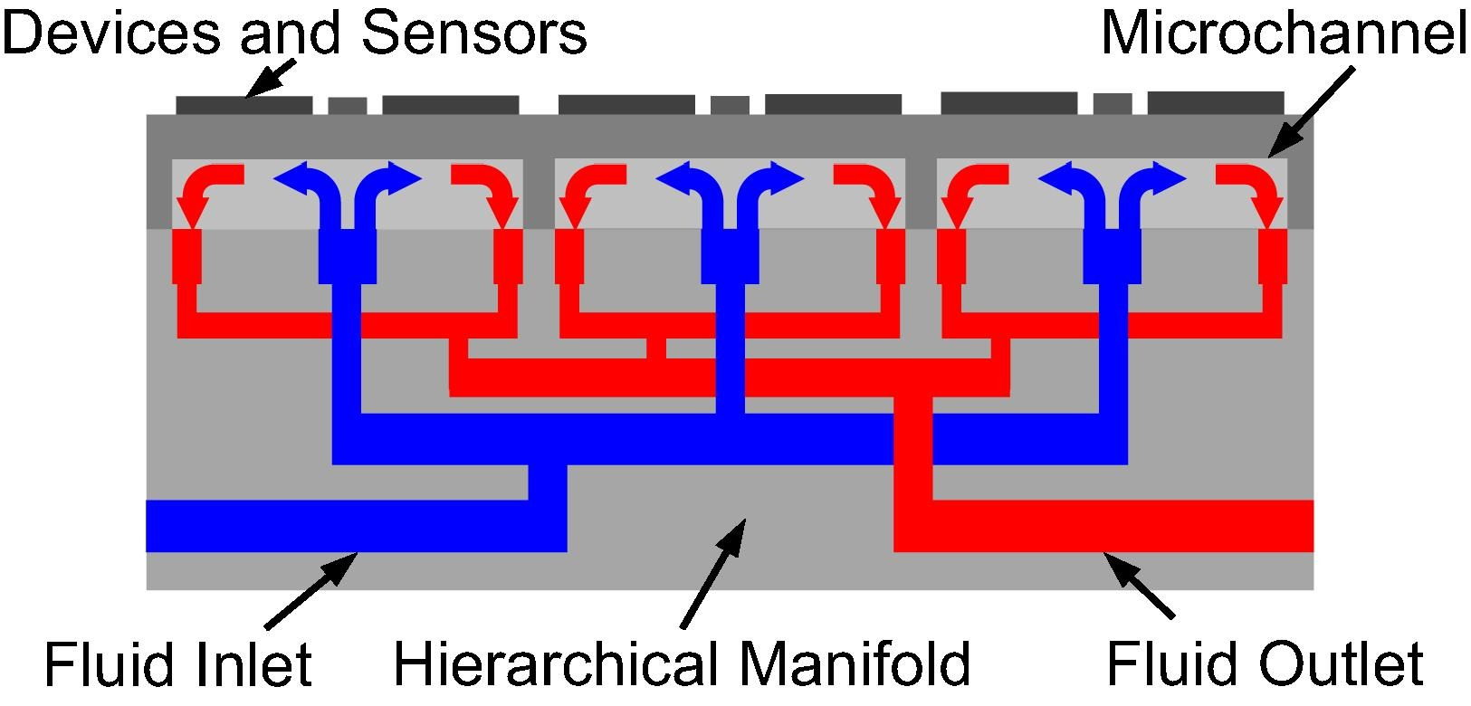
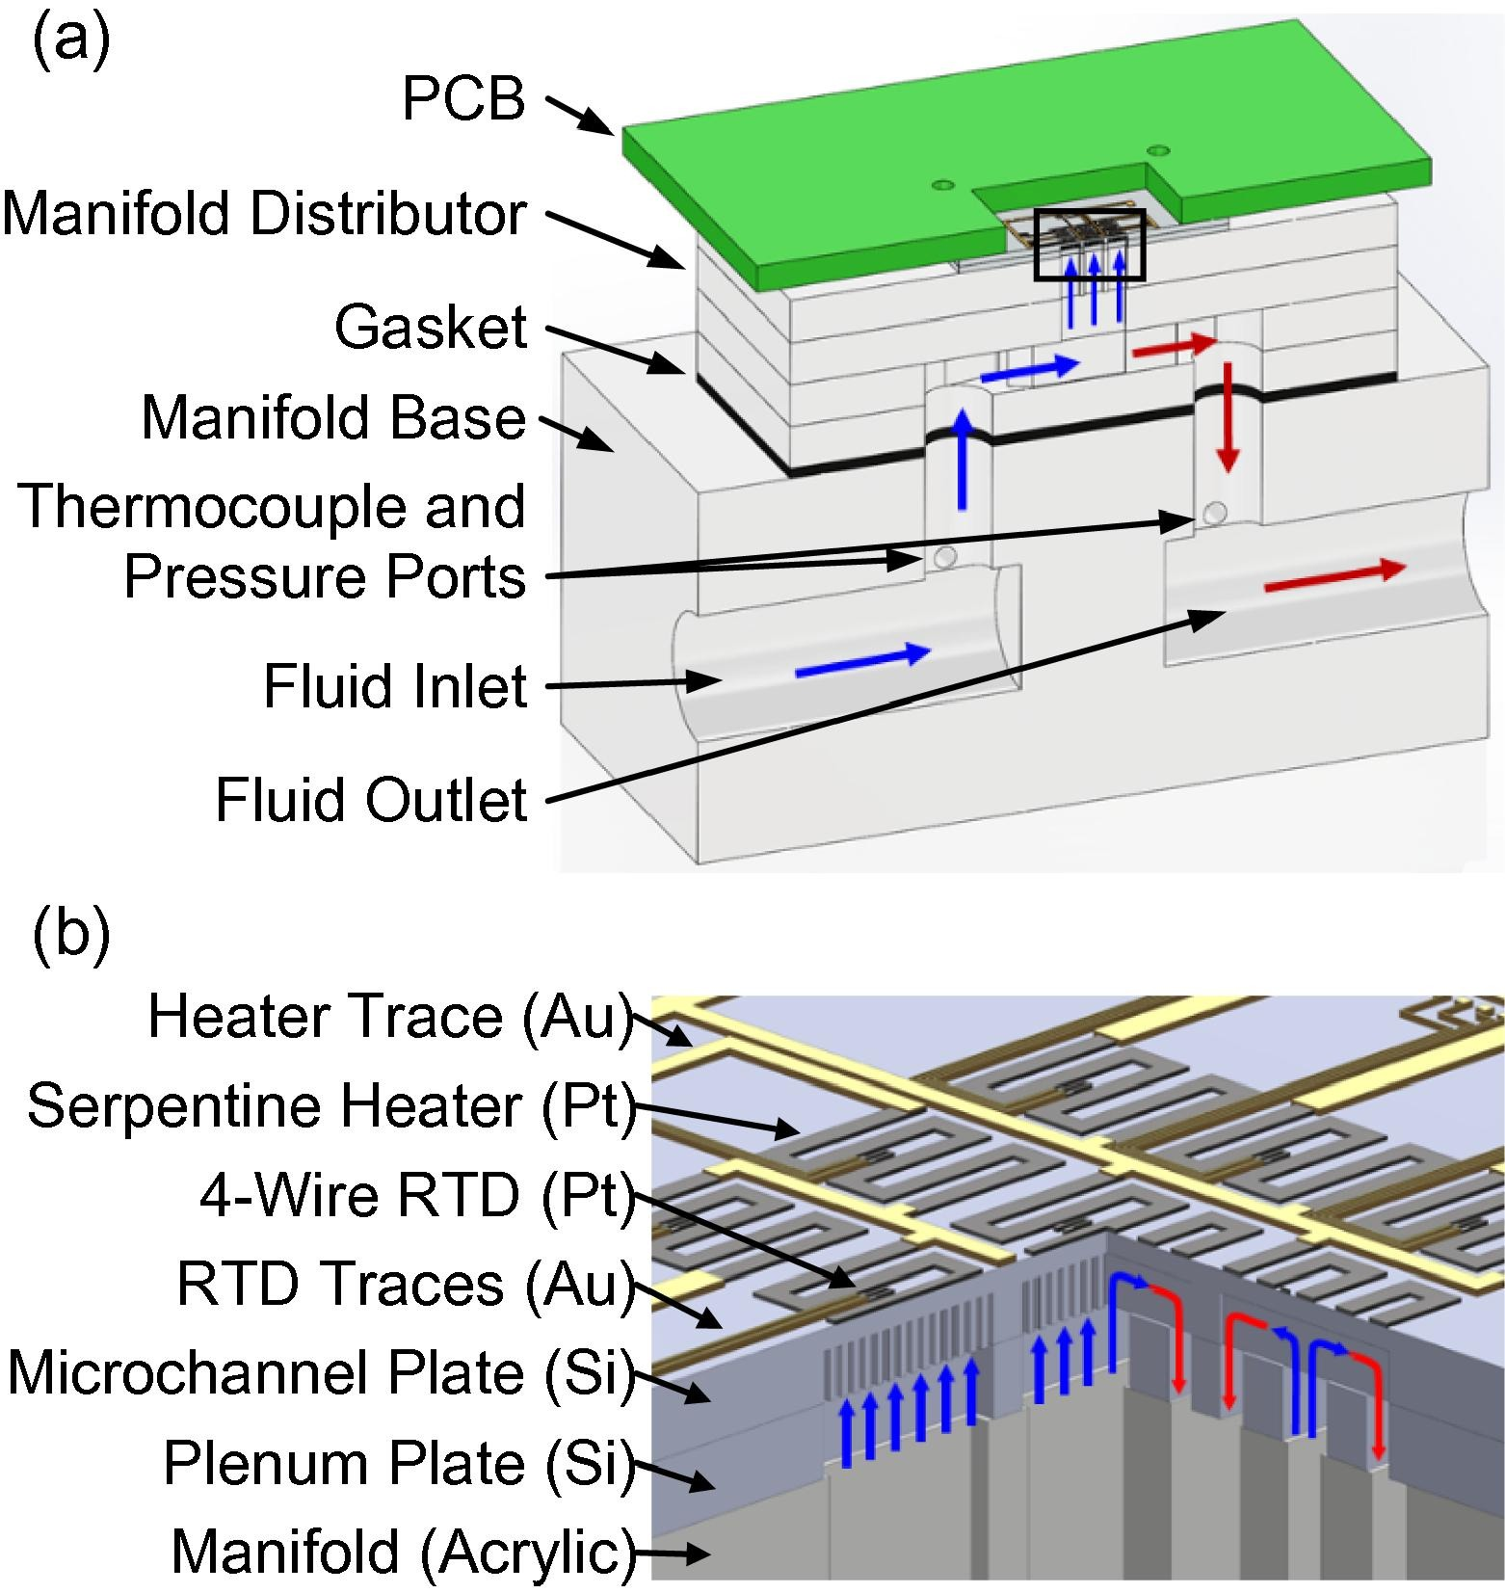
Purdue 2017: 1000 W/cm² liquid cooling demo
A hierarchical manifold microchannel heat sink array for high-heat-flux two-phase cooling of electronics
Kevin P. Drummond a,c, Doosan Back b,c, Michael D. Sinanis b,c, David B. Janes b,c, Dimitrios Peroulis b,c, Justin A. Weibel a,c, Suresh V. Garimella a,c,⇑
a Cooling Technologies Research Center, an NSF I/UCRC, School of Mechanical Engineering, Purdue University, West Lafayette, IN 47907, USA b School of Electrical and Computer Engineering, Purdue University, West Lafayette, IN 47907, USA c Birck Nanotechnology Center, Purdue University, West Lafayette, IN 47907, USA Received 27 May 2017, Revised 3 October 2017, Accepted 3 October 2017, Available online 12 October 2017.
Self-similar hierarchical manifold distributes coolant using multi-level bifurcation (k-ary tree), achieves 1000 W/cm²
Processor, GPU, Neural Engine chip(s) would be in direct contact with upper surface of hierarchical manifold heat sink

Slide 20
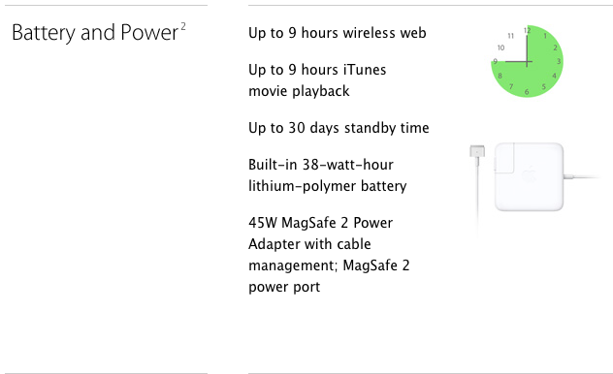
Macbook Air 11” battery tech spec
7 hours battery claimed in mid-2012 when I bought one; yet HW unchanged by 2014 when 9 hour battery claimed.
Test conditions identical.
How can 9 hours be true?

Slide 21
Energy saving examples from Apple From OS X Yosemite Core Technologies Overview, Oct. 2014
Page fault is time consuming & energy intensive
Choose overwrite clean page or write back dirty page [Write back time & energy: hard disk spin up, seeks to track, write, park head, spin down]
Bring in page causing fault [Seek disk head, read page into DRAM, park heads, spin down disk]
All because every page frame is full. 🍋 👎
If only there were an open page frame: no need to write back, saving ½ the access time and ½ the energy; plus no worries about re-loading a page
Hmmm …
😃💡🍹

Slide 22
Idea – make room in DRAM – and Theory From OS X Yosemite Core Technologies Overview, Oct. 2014
Information resolves uncertainty (Claude E. Shannon, Bell Labs, 1948)
Rare event outcome becomes known ➔ More information produced
Information measured as H = - ∑ p_{i} log₂(p_{i}) where p_{i} is probability of the i^{th} symbol with units of shannons/symbol or, because of log₂ , bits/symbol
From the given equation H_{maximum} = 1 shannon/symbol or 1 bit/bit
Examples
Fair coin toss (toss result ∊ {heads, tails}, p_{i} = 0.5 for each result) information?
H = -(0.5 log₂0.5 + 0.5 log₂0.5) = 1 shannon/symbol = 1 bit/bit
Bytes in memory containing BCD digits ∊ {0b 0000 0000 through 0b 0000 1001}, assume each decimal value ∊ {0,1,2,3,4,5,6,7,8,9} has equal probability, 0.1
H = -∑ 0.1 log₂(0.1) = 3.32 shannon/BCD_digit = 0.415 bits/bit
Why H < 1? BCD starts 0000, so 0 symbol is common, 1 is relatively rare
Other unequal 0 & 1 use, perhaps: Fill unused machine instr. fields with 0
Typically, main memory contains less information than 1 bit/bit
Compression is the act of transforming a bit string from an initial format to a compressed format so that H_{compressed} > H_{original} thus requiring fewer symbols
Bottom line: The bit string filling a page frame is often quite compressible

Slide 23
Apple idea: use CPU time instead of disk space to open a page frame in DRAM
MacOS compresses pages automatically when DRAM tends towards full
Compressing using CPU takes less time (~ 5 µsec) and less energy than writing 1 frame to disk (~10 msec)
Bring pages due to page faults into now-open frames
Uncompress DRAM pages when needed, also fast
MacOS “compressed memory” software designed to
run in parallel on multiple cores and to
not use and not need TLB, so
will not push out TLB entries of faulting process (which is called polluting the TLB) and, thus
after returning from the page fault handler, the TLB still holds the all of the hot translations of the current process
Notes:
What change to the physical memory hierarchy could achieve a similar performance boost as Compressed Memory? Ans: Doubling the amount of DRAM in the machine.
What would the effect on power consumption be for this memory change? Ans: Double the DRAM power consumption.
What does not using the TLB and virtual page table mean? OS keeps its own index of compressed memory; if something needs to be uncompressed the time to locate is amortized across the decompression time and still comes out ahead of the time for a disk access.

Slide 24

Apple example 2: App Nap
Unused App put in a state to reduce CPU and I/O use when (1) its window is hidden and (2) it is not playing audio
Timer throttling. Reduce firing frequency of app’s timers. This can mean significant increases in CPU idle time (low power mode) for applications that frequently check for data.
I/O throttling. Assign lowest priority to disk or network activity associated with a napping app. Significantly reduce the rate at which an application can read or write data from a device. Also reduces the chances that a background process will interfere with the I/O activity of an app in active use.
Priority reduction. Reduces the UNIX process priority of an app so that it receives a smaller share of available processor time. [ Automatically nice the process. ]
Cost: Loss of rear window defrost feature of the GUI
Best GUI feature name. Ever.
Notes:
I think Rear Window Defrost is one of the best names ever for a graphical user interface feature.
Now if there was only a GUI for this time of year that featured heated seats.

Slide 25
Apple example 3: Timer Coalescing
Reduce amount of system maintenance and background work done when device is running on battery power
Apple’s Software Update checks every 7 days by default; on battery power will delay up to 1 day
Tasks on timers can be designated to never run on battery power, e.g., software update downloads
CPU idling reduces power use, so find a way to do exactly the same work yet increase time spent idling
Notes:
Cf. is an abbreviation of the Latin word confer; in English often also taken as “compare with”

Slide 26
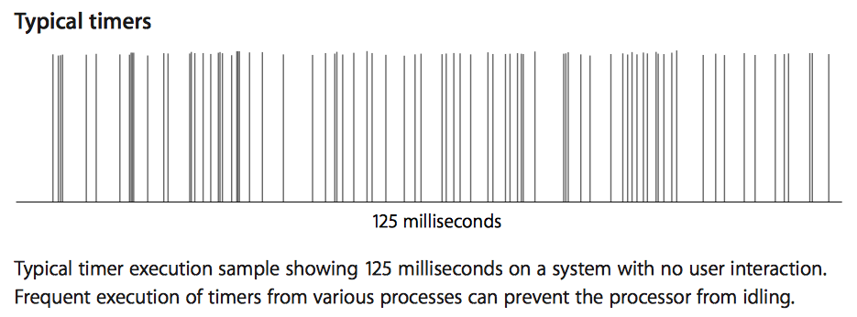
Before timer coalescing
CPU wake up and prepare for sleep energy
CPU energy for timer task
KEY FACT: Many timers are not fussy at the
millisecond time scale about when their task is executed: slide timers together to share one wake up and one prep-for-sleep energy cost
Expanded time scale
for example timer task

Slide 27
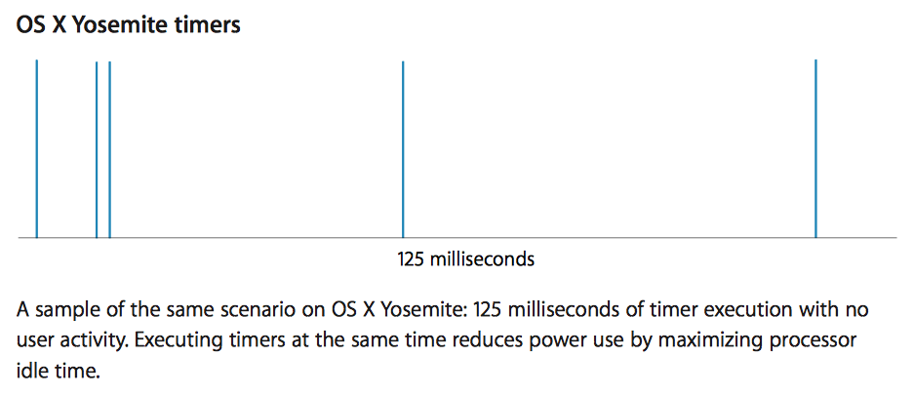
After coalescing
The three examples presented on this slide and preceding seven slides are from “OS X Yosemite Technical Overview” Apple, Inc., October 2014, pp. 7 - 9.

Slide 28
but also reduces the noise margin
^

Slide 30
Final exam coverage and format
Final exam covers
Textbook chapters 1 through 22
All lectures
All homeworks
All labs
Final exam format
50 multiple choice questions at 3 pts. each
Some emphasis on material since Midterm 2, yet, comprehensive coverage of the semester
Closed book, closed notes, no calculators

Slide 31
Final exam location
Final exam time and place: STEW 183, also known as (aka) Loeb Playhouse Monday, Dec. 11 10:30am to 12:30pm

Slide 32
Final logistics
Use restroom prior to arrival; 2-hour exam
Upon arrival, leave all items except pencil and eraser outside the seating area
Pick up “lap desk”, enter, and find a seat
Permission_to_exit_your_seat_algorithm: while (student sitting in your path to aisle) { wait in your seat; }
Algorithm intended to improve the quality of the exam environment

